Slide 1
Alder Lake-S OEM & ODM CRD Survey Report
(Desktop Segment)
CONFIDENTIAL
Contained customer process information under NDA
Customer participated:
ACER, AS ROCK, ASUS, DELL, LENOVO, MSI, LITEON, FOXCONN, LCFC, ECS
2020 - WW45 Rev 0

Slide 2
Revision History
# | Rev | Date Released | Change Description
1 | 0 | W45 Y2020 | New doc

Slide 3
Agenda
Desktop Customer Landscape
Key Takeaway
Additional Feedback / Concerns
Observation / Next Step
Printed Circuit Board (PCB) Design
PCBA Factory Process
  Automation
  Paste Printing
  Pick and Place
  Reflow
  Wave Solder
  Board Level Adhesive Process
  ILM Cover / Lever / Assembly
  Process Inspection / Monitoring
  PCBA Test Process
  PCB X-Ray
  Rework
  Others
Acknowledgment
Back Up
Notes:
Gigabyte: https://www.youtube.com/watch?v=bR-DOeAm-PQ; https://www.youtube.com/watch?v=cnAFTMaS5R0

Slide 4
2020 Desktop Customer Landscape
Q1 2020 DESKTOP OEM MSS%
Customers Providing Survey Results
Q1 ’20
Lenovo | 24.4%
HP Inc | 21.5%
Dell Inc | 19.7%
Apple | 6.9%
Acer | 5.6%
Asus | 5%
Others | 16.8%
OEM | ODM | Site | Design / SMT / SI | Qty/Qtr
Acer | Wistron |  | DESIGN
AS Rock |  |  | DESIGN
Asus |  |  | DESIGN
Dell Inc |  |  | DESIGN
Lenovo | MSI |  | DESIGN
MSI |  |  | DESIGN
Dell Inc | Foxconn | Mexico - Juarez | SI | 400ku/qtr
 | Foxconn | Wuhan | SMT & SI | Unknown
HP Inc | Foxconn | Wuhan | SMT & SI | 600ku/qtr
 | Foxconn | Czech Republic -Pardubice | SI | 600ku/qtr
Lenovo | Liteon | Dongguan | SMT | 400ku/qtr
 | LCFC | Hefei | SMT | 230ku/qtr
 | MSI | Unknown | SMT | Unknown
 | ECS | Shenzhen | SMT & SI | 200ku/qtr
For Example:
Gigabyte (1.8Mu/qtr)
MSI (1Mu/qtr)
AS Rock (600Ku/qtr)
SuperMicro
Note: For ODMs shown in blue, some limited MV/factory info was also collected

Slide 5
Key Takeaway (1)
PCB Design
  OEMs have design ownership of PCB, System and Thermal Solution.
  OSP is the most common PCB surface finish with 62 mils board thickness, followed by ~47/48mil thickness and minimum via drill diameter of 8-10mil.
  Most customer choose Type 3 board with 4/6/8 layer and 140-150°C Tg PCB lamination.
  ATX is the most common form factor design, there are also other form factors used.
  Majority of the customers have capability to support double sided assembly process.
    Backside (secondary side) assembly process is fully automated for SMD components and capability constraints/limitations vary by customer.
    0201 is the smallest chip component size supported, across all board designs.
    Component spacing rules vary by customer.
  Approximately 60% of the surveyed customers allow for trace routing between chip component pads.
  Customers have more concerns and paying more cautious for large SMT connectors, eg. include soldermask between the pins in their design to mitigate SMT risk.
  Customers perform reliability testing in board level and some in system level, the reliability tests are different among all.
  Customers use both their proprietary and Intel designs for thermal solutions. They do follow thermal relief rules.

Slide 6
Key Takeaway (2)
ODM PCBA Process & Rework
  Customer is trending to full automation for SMT assembly with in-line traceability capability set-up. Approx. 50% of the surveyed customer achieved full automation while others are partial automation.
  Pin and vacuum PCB support are used at paste print process. Approx 50% of the surveyed customer choosing pin type , while the remainder are using both pin and vacuum support.
  Customer preferred stencil thicknesses: 0.10, 0.12, 0.13 & 0.15mm for both SMT and rework.
  Pallets are generally used for board support during SMT reflow and rework. Most customers directly applied solder paste on PCB pads for rework. Few customers also print solder paste onto the solder balls.
  Approx 80% of the surveyed customers reflow with purging N2 (O2 ppm range between 1K-3K) and other reflow @ Air environment.
  No O2 ppm control for wave soldering process for most customers and PCBA rework process mostly performed at air environment.
  Many customers are not sharing their paste vendor info and machine/equipment model with Intel.
  PnP minimum ball pitch recognition capability is 0.3mm.
  Customer prefer peak reflow temp range from 230-250°C.
  Customers are not using adhesives for sockets but using it for BGAs. Customer common practice is to apply adhesives before board testing.

Slide 7
Key Takeaway (3)
Inspection/Test/ILM/Others
  SPI is generally performed 100% and control limits range target between 60%-180%.
  AOI is performed on 100% of components and located after reflow.
  PCBA x-ray inspections is typically performed offline by sampling, no common sampling rate. Most customers are performing bed of nails and functional tests
  Customers prefer the ILM cover to “pop off” with CPU inside socket & ILM cover closed.
  Beat rate to install or remove an Intel LGA CPU from the socket ranges between 12-15 seconds, they are concerns with socket-V lever latching at opposite direction and manufacturing run rate impact due to ILM assembly for socket-V (4-screw, 2-pcs top-plate) vs socket-H (3-screw, 1-pcs top-plate)
  Customers have not experienced any ESD issue related to the ILM cover for socket-H.
  Customers find the Desktop MAS helpful and think a System Assembly video is required. CPU assembly and PnP tool video played during Intro meeting is customers’ favorite.
  Customer is looking for solution/tool that is “executable” for manufacturing process/variation (eg. ILM) and design fungibility (eg. thermal solutions)
  SJQ concerns for potential insufficient total solder volume (~10% lesser?) in solder joint formation. LOTES (0.45mm ball size) vs FIT/Deren (0.5mm ball size) but MAS recommended the same solder paste volume.

Slide 8
Additional Feedback/ Concerns (1)
Customer | Area of Concerns
AS Rock | Mixing & fungibility concerns, expects socket-H vs skt-V Thermal Solution is interchangeable. The hole pattern looks alike to CML-S, with distance between hole 75mm vs ADL-S is 78mm. There are additional cost and manufacturing mixing concerns when there are 2 different solutions for DT tooling, need to make it fungible due to the dimension is ~3mm delta that not noticeable by operator.
LiteON | Processor PnP tool /Stage > LiteON will be converting to automation, the PnP/assembly tool may not helpful. Automation assessment is in progress (eg. assess utilizing Cobot with tool/fixture ). They plan to perform some SMT build in Oct/Nov.
Acer | SJQ concern> LOTES socket with smaller solder ball (0.45mm, 10% smaller), compare to Deren/FIT (0.5mm) but MAS recommended paste are same for FIT/Deren/LOTES. Need intel to perform more data collection to ensure the same amount paste volume recommended in MAS is good for LOTES HVM. Meantime, need Intel technical explanation of why mechanical ball attached in LOTES need smaller ball & still OK to use the same paste volume & etc. Pin 1 indicator error> Different pin 1 indicator on PnP stage vs PnP tool vs PCB, ILM. Need Intel to ensure final design is correct.
Lenovo SZ (LIPC) | Interchangeable for backplate/load plate/screw/lever & etc > Need to allow mixed vendor to ease mfg process, due to there are more pieces for socket-V (eg. allow mixed 2 vendor for lever and top plate due to 2 separate pcs). Need Intel to confirm the 4 mounting screws/nuts PN# are same. CPU installation to socket/ILM > Need Intel to confirm any error in step, and when the cover pop-up. “Error Free” design requirement for backplate and ILM dimension for HVM assembly> Need Intel to provide back plate dimension whether it is effective for LIPC can design an automation/fixture for backplate assembly to prevent 180° orientation (the chamfer look insignificant in picture and looks symmetrical), also potential operator installing the load plate + lever frame wrong side (vs skt-H, 3 screw, no way to install at wrong side). Socket Pin contact dimension> Due to tighter pitch in skt-V (0.8mm), need Intel to provide pin dimension & ensure type 3 x-y axis shift always making “good” contact to the LGA pad center. SJQ concern> Need intel to perform more validation data collection to ensure 5 mils stencil is working for LOTES HVM. Socket & Tray> Need to ensure CTF dimension are same across all vendors, so that PnP only need to set-up 1 recipe. Confusing Pin 1 indicator for PCB/ILM vs PnP tool/stage.

Slide 9
Additional Feedback/ Concerns (2)
Customer | Area of Concerns
LCFC | Run rate impact> Additional 1 screw (Skt-H 3-screw to skt-V 4-screw) and assemble 2-pcs topplate (vs skt-H 1-pcs topplate) ILM lever latch direction > Skt-H is pulling the lever inward, but Skt-V is pushing the lever outward. This is not manufacturing friendly as the same operator will be processing skt-H and skt-V.
FXWH | ILM > Quality control for the screw & nut thread tolerance among different vendors, variation by batch/datecode for individual vendors. Backplate/load plate/screw/lever & etc > Need to allow mixed vendor to ease mfg process, due to there are more pieces for socket-V (eg. allow mixed 2 vendor for lever and top plate due to 2 separate pcs). ILM gap to PCB (Warpage?) > Per skt-H experience, FXWH observed gap/seperation between the ILM vs PCB. Worried if skt-V ILM will hv similar issue especially there are 2 pcs for top plate and lever pcs, if there are PCB warpage, will the situation get worsen ? And resulting poor socket contact pin to LGA pad. (eg. potential scenario with package tilted in socket, and not all pin/package unable to get the similar compressive load resulting poor or marginal contact) Torque setting requirement and expectation > Need to “range” for manufacturing process, (eg. 8-in-lbf ± xx %) due to in actual process/production there are no way for absolute value 8-in-lbf, there are variation between batches/vendor for the screw/nuts, torque driver capability & etc.
Intel FAE | Socket bend pin pass/fail criteria in MAS> Need to re-assess the type 3 x-y axis shift visual criteria for ±0.125mm, due to tighter pitch in skt-V (0.8mm) vs skt-H pitch 0.914mm. Is the contact pin always making contact to the LGA pad center ? Will the contact pin that passing 0.125mm still passing electrical test ? as the pin may be touching/ too close to the adjacent CPU LGA.
Key Message (combined both slides)
Customer is looking for solution/tool, with design fungibility that is “error free“, “executable” for HVM process transparency or variation, (eg. opposite lever latching direction, thermal solution design, orientation control, allow mixing piece parts & etc)
Concerns is manufacturing run rate impact for socket-V for ILM assembly (additional top plate and screw)
SJQ concerns due to potential insufficient total solder volume for solder joint formation
                LOTES (0.45mm solder ball) vs FIT/Deren (0.5mm solder ball) but MAS recommended same solder paste volume

Slide 10
Observation & Next Step
Observation
  Few customers were not excited about Intro meeting (eg. ECS, MSI, HPI, QCMC) or participate in CRD survey (eg. QCMC, Gigabyte, MSFT)
    Customers already get used with the working model with Field Engineer/account team for ~10 years without CQR/CME enabling
Next Step
  Demonstrate our values and collaborate with Field Engineer/account team for future customer enabling in DT segment
  Proactively follow-up with customer for their development activities/NPI for Socket-V and offer help to re-build customer relation
  Follow-up with LiteON for their Oct/Nov SMT build result and automation assessment
  To seek clarification from customers for items label in this color

Slide 11
Acknowledgment
Customer | Account CQE
Acer | Jeremy Chang
AS Rock | Sean Bao
Asus | David Wang
Dell Inc | Allan Leal, Samer Alaiyoubi, Arturo Rios
ECS | Sean Bao
Foxconn WH | Sean Bao
HP Inc | John Burtchaell
LCFC | Shirley Zhang
Lenovo | Jiang Art, Albert Tsai
Liteon | Sean Bao
MSI | David Wang, William Pan
QCMC | Juanita Ren

Slide 12
Back Up

Slide 13
Printed Circuit Board Design (1)
Area of Interest | LENOVO (MSI) | DELL | ACER (WISTRON) | ASUSTEK | MSI | ASROCK
Do you have PCB design ownership | Yes | Yes | Yes | Yes | Yes | Yes
Do you have Full System Design Ownership | Yes | Yes | Yes | Yes | No, only for channel MB | No, Motherboard only
Do you have Thermal Solution Design ownership | Yes | Yes | Yes, for AIO/miniPC, No, for Tower (Owned by Acer) | Yes | Yes | Yes, but only for PCH and Vore MOS heatsink
Please list the PCB suppliers used by % | GBM, APCB, Hanstar, Junya (骏亚), ECS (15%), Palwonn, VGA, etc… | Not Answered | 4 Layer: CEE(1st) / GLOBALBRAN(2nd) / VICTORY(3rd) 6 Layer: Hannstar(1st) / CEE(2nd) / GLOBALBRAN(3rd) 8 Layer: Hannstar(1st) / GLOBALBRAN(2nd) | TRUSTECH(40%), GECS(30%), DF(15%), DYEC(15%) | Vendor A(30%), VendorB(70%) | Trustech(50%), Dingfu鼎富(50%)
Please list the PCB surface finishes used by % | OSP | OSP(100%) | OSP(100%) | OSP(100%) | OSP(100%) | OSP(100%)
Please list the PCB board thicknesses used by % | 62mil(90%), 48mil(10%) | 62mil(70%), 47mil (30%) All of the "Micro" form factors in Dell's Desktop portfolio use 47 mil (1.2mm) thick PCBs. This equates to ~4-5 million units of volume and ~30% of their Desktop volume. All other Dell Desktop products use 62 mil (1.6mm) thick PCBs, which equates to ~70% of their Desktop volume. | 62mil(75%), 47mil(25%) | 62mil(100%) | 62mil(80%), 59mil(20%) | 62 mil(90%), 59 mil(10%)
Key Message
OEMs have design ownership of PCB, System and Thermal Solution
OSP is the most common PCB surface finish
While 62mil is the most common PCB thickness, ~47/48mil are also commonly used by 3 customers

Slide 14
Printed Circuit Board Design (2)
Area of Interest | LENOVO (MSI) | DELL | ACER (WISTRON) | ASUSTEK | MSI | ASROCK
Please list the PCB Laminate Tg used by % | 150°C Tg(50%), 140°C Tg(50%) | 150°C Tg(100%) | 145°C Tg(100%) | 150°C Tg(50%), 140°C Tg(30%), 170°C Tg(20%) | 150°C Tg(100%) | 140°C Tg(80%), 150°C Tg(20%)
Please list the PCB type that is used by %? | Type 3(100%) | Type 3(100%) | Type 3(100%) | Type 3(100%) | Type 3(100%) | Currently use Type 3(100%), but we will validate type 4 for PCIE5
Please list the PCB layer count that is used by % | 4 Layer(65%), 6 Layer(30%), 8 Layer(5%) | 4 Layer(60%), 6 Layer(25%), 8 Layer(15%) | 6 layers(50%), 4 layers(25%), 8 layers(25%) | 6 Layer(40%), 4 Layer(30%), 8 Layer(30%) | 6 Layers(70%), 4 Layers(20%), 8 Layer(10%) | Currently use 6 Layer(100%), but we will validate 4 Layer PCB
Please list the PCB board form factor that is used (by %)? | Non-standard sizes, e.g. 267mm x 245mm, 267mm x 220mm, 170mm x 170mm, etc... | Custom(100%) | mATX(25%), DTX(25%), AIO(25%), miniPC(25%) | ATX(80%), uATX(20%) | ATX(43%), MATX(33%), ITX(19%), EATX(5%) | Our first project is ATX. Usually we might have ATX(40%), uATX(30%), mini-ITX(15%), and AIO(15%) in the future.
What % of your designs are double sided assembly ? | Double sided(90%), Single sided(10%) | Double sided(90%), Single sided(10%) | Single Sided(90%), Double sided(10%) | Double Sided(80%), Single Sided(20%) | Double Sided(100%), Single Sided(0%) | Single Sided(70%), Double Sided(30%),
Is there capability to support 100% of your volume with double sided components? | Should be OK | Yes | Yes | Yes | Yes | Yes, we can support 100% double sided components
Key Message
140-150°C Tg PCB laminate are the most common
Type 3 and 4/6/8 layer PCB designs are the most common
While ATX is the most common form factor design, many other various form factors are also used
It is most common for customers to have the capability to support double sided assembly

Slide 15
Printed Circuit Board Design (3)
Area of Interest |  | LENOVO (MSI) | DELL | ACER (WISTRON) | ASUSTEK | MSI | ASROCK
Via & Pad | What is the minimum via pad stack (drill diameter / via pad diameter / antipad diameter)? | 10mil drill / 20mil pad / 31mil antipad | 8~10mil drill / 18mil pad / 28mil antipad | 8mil drill (Finish hole size) / 18mil pad / 28mil antipad | 10mil drill / 20mil pad / 30mil antipad | 12mil drill / 22mil pad / 32mil antipad | 10mil drill / 18mil pad / 28mil antipad
 | Are the BGA land area vias not covered with soldermask, or are they capped / plugged / covered with soldermask (no exposed vias)? | covered with soldermask | both are used (covered & not covered with soldermask) | covered with soldermask | covered with soldermask | plugged / covered with soldermask | Full covered with soldermask ( 全塞孔)
Component Sizes | What is the smallest chip component size that is supported for your desktop board designs? | some are 0201 and some are 0402 | 0201 | 0201 | 0201 | 0201 | 0201 is OK
 | Regarding the above question, is this true across all board designs (for example, across all 4 or 6 layer board designs, and across all Type 3 and Type 4 designs)? | Yes, across all board designs | Yes, across all board designs | Yes, across all board designs | Yes, across all board designs | Yes, across all board designs | Yes, across all board designs
Key Message
8-10mil is the most common minimum via drill diameter
0201 is the smallest chip component size supported, across all board designs

Slide 16
Printed Circuit Board Design (4)
Area of Interest |  | LENOVO (MSI) | DELL | ACER (WISTRON) | ASUSTEK | MSI | ASROCK
Component Placements | Is backside assembly a fully automated process | Fully automated process | Fully automated process | Fully automated process | Fully automated process | Fully automated process | Fully automated process
 | Any limitations on backside SMT component placement (quantity, chip size)? | Part Height: Needs to be less than 3.5mm. Constraints: Cannot put connector / socket for most product, need to be far away from the PCB edge (more than 6mm). | Quantity: Balance component quantity for top and bottom side | Chip Min: 0201 Component Max size: 100mm*90mm BGA: Max pitch: 0.5mm Size: 5x5mm to 45x45mm Smallest Diameter: 0.25mm QFP: Size: 5x5mm to 45x45mm Smallest Spacing: 0.4mm Smallest Lead Width: 0.2mm | Part Height: Only the part height is limited to 6mm on backside Quantity: The quantity is not limited | Placement: Backside SMT components must be placed away from the edge of board by at least 200mil (5mm) Via/Through Hole: Distance between "VIA & Through hole (PTH & NPTH)" and SMD PAD must be equal or greater than 6mil (0.15mm) Vias: It is strictly prohibited to lay VIA hole (including PTH) beneath SMT component Part Height: -Backside component height must be equal or less than 12mm for double-sided process board -If SMT component height (t) ≦2mm, distance between backside DIP pin and SMD component (x) must ≧3mm. -If SMT component height (t) ≧2mm (The height can't over 12mm), distance between backside DIP pin and SMD component (x) must ≧4mm. Quantity: And the component Q'ty should be ≦ 1000pcs | Quantity: No rule, so far the maximum backside component quantity is 1243 Chip size: No rule, so far the maximum backside component is Intel LGA1200 socket Beat rate: The backside SMT will use a slower pick & place machine.
Key Message
The backside assembly process is fully automated for all customers
Backside component constraints & limitations vary by customer

Slide 17
Printed Circuit Board Design (5)
Area of Interest |  | LENOVO (MSI) | DELL | ACER (WISTRON) | ASUSTEK | MSI | ASROCK
Component Spacing | Min spacing for 0402 to 0402 | Min spacing: 1.5mm, 2mm is better | pad-pad ≥0.3mm (12mils) | 0.25mm | 0.3mm (12mils) | 0.05mm | 0.15mm
 | Min spacing for 0603 to 0603 | 1.5mm | pad-pad≥0.3mm (12mils) | 0.30mm | 0.3mm (12mils) | 0.05mm | 0.18mm
 | Min spacing for 0805 to 0805 | 1.5mm | pad-pad≥0.3mm (12mils) | 0.40mm | 0.3mm (12mils) | 0.05mm | 0.18mm
 | For through-hole components (e.g. leaded caps), what is the minimum body-to-body spacing requirements for assembly? | ≧0.5mm (20mil) | 2.54mm to 3.0mm (100 to 120mils), ODM depedant | 2mm | minimum body-to-body spacing requirements is 0.61mm (24 mil) | 0.50mm each cap frame spacing (≧0.5mm (20mil) | 0mm between component allegro symbol outline
 | For large SMT components (e.g. inductors), what is the minimum body-to-body spacing requirements for assembly? | ≧0.5mm (20mil) | 1.0mm to 2.54mm (40 to 100mils), ODM dependant | 2mm | minimum body-to-body spacing requirements is 0.30mm (12 mil) | Not answered | 0mm between component allegro symbol outline
 | For components inside the socket cavity, what is the minimum chip-to-socket cavity-wall spacing requirements for assembly? | ≧0.5mm (20mil) | 2mm | 1mm | minimum chip-to-socket cavity-wall spacing is 1.0mm (40 mil) | All the caps around the CPU SKT should be >0.2mm | 0mm between component allegro symbol outline
 | For the above question, is this minimum spacing set for rework reasons or for other assembly considerations? (please explain) | Above spacing is set for request for rework limitation and progress assembly in MFG | Above spacing is set for both rework and assembly considerations | Above spacing is set for Chip to BGA 2mm | Above spacing is set for rework reasons | Above spacing is set for: Component Placement, Assembly, Installing, Crashworthiness and maintenance considerations | Above spacing is set for factory assembly
Key Message
Component spacing rules vary by customer

Slide 18
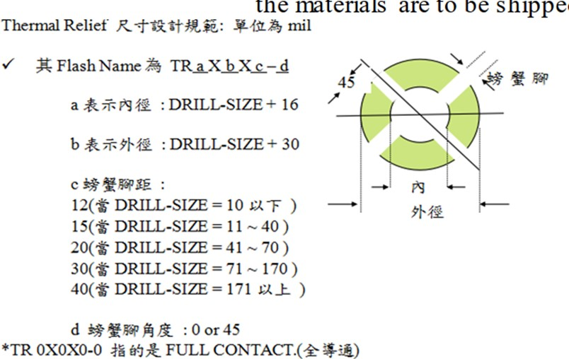
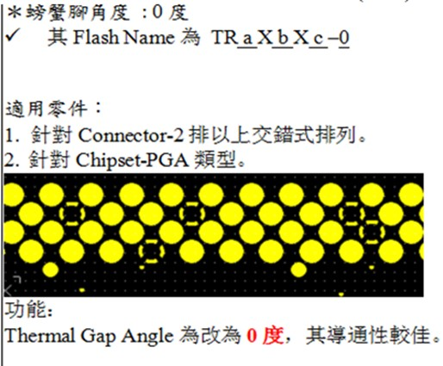
Printed Circuit Board Design (6)
Area of Interest |  | LENOVO (MSI) | DELL | ACER (WISTRON) | ASUSTEK | MSI | ASROCK
Thermal Reliefs | Do you follow any rules / requirements for thermal reliefs? | Yes | Yes | Not Answered | Yes, we follow Intel's KOZ Limit, and by model (Mass / Height, etc...) | Yes | Please refer to the graphic below
Trace Routing for Passive Components | Do you allow for trace routing between the pads, or underneath the pads, of chip components, such as 0603 and 0805, etc...? | No, not suggested, because of the layout solution, due to interference problems. If were to modify the trace width to through the pad, the impedance may not meet the SPEC. | Yes | No, concerns: 1. The signal performance will be poor. 2. It will cause a short issue due to poor soldermask coverage 3. It will cause poor solderability due to trace thickness is higher than the pin | Yes | No, must consider soldermask application, especially in the dark soldermask / registration | Yes, but only when there is not other solution
*
*
Key Message
Customers do follow thermal relief rules
3 customers allow and 2 customers don’t allow for trace routing between chip component pads

Slide 19
Printed Circuit Board Design (7)
Area of Interest |  | LENOVO (MSI) | DELL | ACER (WISTRON) | ASUSTEK | MSI | ASROCK
Trace Routing for Large SMT Connectors | We see a trend with higher speed IO to move to large SMT connectors (e.g. PCIe, DDR UDIMMs). Do you see any issues or concerns with these types of connectors? | Yes, reliability is a concern for a long slot, such as PCIe Gen5 and DIMM DDR5. Another concern is that it will add more VIAs and layers. | Need to evaluate case by case | There are no concerns for Desktop, this concern should be for Server. Basically, we will follow Intel's Demo board design. Meanwhile, we will check with our EE and ODM. | Need extra VIA for routing trace to TOP layer | Yes, wait for test | Yes. 1) The factory assembly failure rate is much higher than DIP type slot, and 2) SMD type is difficult to rework / repair.
 | For large SMT connectors (e.g. PCIe, DDR UDIMMS, etc…) with pitch ~0.85mm to 1.0mm, do you allow for soldermask between the pins or are ganged soldermask openings a requirement? (see pic) | We are forbidden to do this type of design. | Need to have 0.20mm (8 mils) air gap from trace to adjecent pin pad | Trace between pins must be covered with soldermask to prevent short issue | Need to allow for soldermask between the pins | Need to cover between the pins with soldermask | Alder Lake design is still in Layout process, but we think soldermask is a must for production quality control. We can route between the pins with minimum 1. Trace width = 0.0889mm (3.5mil) 2. Pad width = 0.1778mm (7mil) 3. Pad to trace = 0.12065mm (4.75mil)
 | For the above question, Intel is planning to route traces between these pins (please refer to graphic on the right), do you have any concerns? | We are forbidden to do this type of design. | Soldermask is required to prevent short during assembly process | The spacing between the pin and trace must be larger than 0.1143mm (4.5mil), and the minimum trace width must be at least 0.0889mm (3.5mil) at least | Yes, It's more challenging to routing the DDR5 trace for 4 Layer PCB designs | Pin to line gap must be 0.127mm (5mil) minimum to avoid shorting risk | For 2DPC DDR5 design, Intel PDG still shows TBD and no RVP board file available for us to download. We will need to try this routing by ourselves. From Intel's documentation: "DDR5 UDIMM 2DPC Design Guidelines are TBD"
Key Message
Customers tend to be cautious and have some concerns with large SMT connectors
If large SMT connector pins are used, Customers need to have soldermask present between the pins

Slide 20
Printed Circuit Board Design (8)
Area of Interest |  | LENOVO (MSI) | DELL | ACER (WISTRON) | ASUSTEK | MSI | ASROCK
Reliability | Do you perform any reliability validation on your sockets? | Yes | Yes | Yes | Yes | Yes | Yes
 | Are your reliability tests performed at a board and/or system level? | Both Board & System Level | Both Board & System Level (For Board level we use daisy chain test vehicles) | Both Board & System Level | Board Level | Board Level | Board Level
 | Do you use the Intel reference thermal solution (heatsink design) or proprietary design? | Proprietary design for thermal solution | Proprietary design for thermal solution. It depends on the amount of heat dissipation required vs fan speed to remove the heat. Still being reviewed. | Acer is using both the Intel reference thermal solution (for mobile) and proprietary design (for special form factors). The Tower solution is Acer's AVAP (AVAP is Acer's assigned Vendor). | Intel design for thermal solution | Proprietary design for thermal solution | Proprietary Design for VR Not Answered for thermal solution
 | If you use proprietary thermal solutions could you provide any further information on your thermal solution characteristics? | Thermal solution characteristics are case by case | Thermal solution characteristics are form factor dependent. Thermal Engineering still reviewing options. Dell doesn't have a minimum thermal solution range and they typically don't exceed 550g. But for ADL-S (125W SKU) Dell is looking at going up to a ~900g thermal solution. | AIO (All in One) and BOX (small form factor like Intel's NUC design) will follow Intel's rules and design requirements for Thermal solution characteristicts. If no specific design, will follow NB standard design for Thermal solution. | By model (Mass/Height etc.) and Center of Gravity (CG), will follow Intel's design for thermal solution | Thermal solution characteristicts: aluminum design, extended heatsink, thermal pads. | Not available yet.
Key Message
Customers perform board level reliability testing (some also perform system level testing)
Customers use both proprietary and Intel designs for their thermal solutions

Slide 21
Printed Circuit Board Design (9)
Area of Interest |  | LENOVO (MSI) | DELL | ACER (WISTRON) | ASUSTEK | MSI | ASROCK
Reliability | Which type of reliability tests and stress levels do you perform and expect to meet? Please list and describe each test. | 1. Guardband: 0℃, 25℃, 60℃ Burnin for 20 mins 2. IC Guardband test: 0℃, 25℃, 60℃ Burnin for 1 hour 3. Storage temperature & humidity test: -40 ~ 60 ℃ for 96 hours 4. System Operation Vibration Test: Grms = 0.27, 30 minutes per axes. 5. System Fragility Vibration Test: Grms = 1.04, 15 minutes per axes. 6. System Operation Shock Test: 3ms(15G) for 4 Axis (+X, -X, +Y,-Y) , 3ms(30G) for 2 Axis(+Z, -Z) ,half-sine wave, each side will do 1 times. 7. System Fragility Shock Test: 45G/11ms, Trapezoidal wave, 6 Sides, each side shock one time. 8. High/Low temperature: Run 3Dmark 8hour under 40°C / 0°C 9. Etc… | Board level: 1. HALT Test: Temp (-15C to 75C) with 6 minutes Dwell, Vibration (30Grms, 5min). Measuring all chains contact resistances for continuity 10 cycles. Pass criteria: no opens 2. Temperature/Voltage Margin Test 3. Hot & Cold Operation (40C 24hsr, 0C 24hrs) 4. High Humidity Operation (32C 80% 24hrs) 5. Power Cycling Test (40C 80% 1650 cycles , 0C 1650 cycles) 6. Thermal Cycling: Temp (0C to 100C), 1000 cycles. Measuring all chains contact resistance for continuity. Pass criteria: no opens. System level: 1. Non-Operational Random Vibration (1.37Grms, 15min) 2. Non-Op Half Sine Shock Test (105G,2ms) 3. Strain Measurement Test SetUp (105G,2ms) 4. Hot & Cold Operation (40C 24hsr, 0C 24hrs) 5. High Humidity Operation (32C 80% 24hrs) 6. Power Cycling Test (40C 80% 1650 cycles, 0C 1650 cycles) | Both reliability tests and stress levels Acer will provide additional details, and Intel can then provide the feedback (Mak to follow up w/ Morris Yang). | 1. Non-Operation Shock Test: Trapezoidal Shock (Square Wave Shock) a) Maximum faired acceleration: 50G b) Velocity change: 170 inches/sec c) Test direction: 6 orientation face 2. Non-Operation Vibration Test: Non Operating Random Mode a) Axis: X, Y and Z. b) Fixture used (wooden or plastic): fasten the unit to the table. c) 10 min/axis Vibration Frequency Levels Tested: 1) 5 Hz (Frequency), "-" dB/Oct (Slope), 0.01 G squared/Hz (PSD) 2) 20 to 500 Hz (Frequency), "-" dB/Oct (Slope), 0.02 G squared/Hz (PSD) 3. Thermal Shock Test Non-OP: -40℃~85℃, 1.5hr/cycle, 27 cycles | Windows Shutdown Xcopy Heaven Benchmark 3DMark Windows reboot S3 Shock 10 times Vibration (X, Y, Z) 0.5 hrs etc... | Shock Vibration
Key Message
Customers perform vary different reliability tests

Slide 22
PCBA Factory Automation
Process | ECS | LCFC | FXWH | LITEON
PCBA Automation | Yes | Yes | Yes | Yes
Full or Partial automation | Full | Partial | Full | Partial
Test Automation (in-line or off-line) | In-line | In-line | In-line | In-line
Automation machine | Panasonic SMT machine TRI SPI/AOI | mounter, printer, SPI, reflow, AOI, ATE | not answered | SMT: NXT Gen I, II, III Panasonic :NMP&CM602 DIP:CY-450(超越)
What is used to pick Intel’s component | vacuum nozzle | vacuum nozzle | vacuum nozzle | GPRO SMT -- Intel PCH / LAN Chip, vacuum nozzle
Purpose of scanning 2D Matrix | traceability | traceability, inventory check | traceability | traceability, inventory check
Which process require 2D scanning ? | IQC/SMT | SMT | incoming inspection to outgoing shipment | IQC, SMT, DIP, FPT
In-line or Off-line traceability? | In-line | In-line | In-line and Off-line traceability | Both In-line & Off-line
Key Message
For PCBA factory, 2 Customers have full automation and 2 Customers have partial automation
In-line traceability capabilities are most common to have across the customers

Slide 23
Paste Printing Process
Parameter / Capability | ECS | LCFC | FXWH | LITEON | MSI (LENOVO)
Squeegee Speed (mm/sec) | 60-120 | 120 | 80-90 | 100 | 50
Squeegee Pressure (Kg/area?) | 4.5-8kg/cm2 | 2 | 8~10g/mm | 10 | 10
Stencil Separation Speed (mm/sec) | 0-3 | 1 | 1 | 2 | not answered
Under Screen Cleaning frequency (per print) | 2-6 | 5 | 1 | 6 | not answered
Stencil Cleaning Frequency (hrs) | 1 | 4 | 6 | 100 | not answered
Cleaning Process | Pneumatic | Solvent clean | Ultrasonic | Manual wiped paper & Ultrasonic | not answered
PCB support type | Pin, Vacuum | Pin | Pin, Vacuum | Pin, Vacuum | Pin
Do you use the same pallet for paste print, PnP and reflow? | no | no | no | yes | not answered
Maximum board handling (mm, length x width) | 510 x 508.5 | 460 x 360 | yes | 610 x 510 | not answered
Stencil Cut / Coating | Laser | Nano coating | yes | Electroform, Laser cut with electro polish + nano coat | Etching Laser. No electropolish.
Stencil Thickness (mm) | 0.13 | 0.13 | 0.10, 0.13, 0.15 | 0.10 (BGA), 0.13 (skt), 0.15 (other) | Secondary: 0.12/0.15 Primary: 0.12
Stencil Step up/down (mm) | Yes 0.10/0.15 | no | Yes. Depends components, 0.10, 0.13, 0.15 | Yes. Depends components, 0.10 (BGA), 0.13 (skt), 0.15 (other) | not answered
Solder Paste Vendor | not answered | not answered | Eunow EUP-148 | not answered | Shenmao PF606-P
Solder Paste Type | type 4 | SAC type 4 | SAC305 type 4 | Type 4 | SAC305 Type 4
Key Message
Pin PCB support type is most common and several customers also using vacuum support
Customer preferred stencil thicknesses: 0.10, 0.12, 0.13 & 0.15mm
Many customers are not sharing their paste vendor info with Intel

Slide 24
Pick & Place Process
Parameter / Capability | ECS | LCFC | FXWH | LITEON | MSI (LENOVO)
Nozzle size (LGA socket & Intel component) | 1005 | NPM 1003 | Universal 1240F & Fuzion1-11 and Sony CF00900 | Nozzle: 15.0G (skt) Nozzle: 7.0G (BGA) | FUJI NXT1. Nozzle types 0.7/1.0/1.3/2.5/5.0/7.0 /10.0
Max Socket & BGA size capability (x,y, mm) | 90-120 | 45 x 45 | 55 x 55 | 74 x 74 | not answered
Max Socket & BGA weight capability (grams) | 28mm ? | 30 | not answered | 60 | not answered
What component placement force is used for Intel components? | 0.5mm ? | 0.3mm? | 150g | N/A | Factory target is 0
What method of board support is used during placement? | Tray | Pin | Pin | Pin | not answered
Maximum board handling capability (length x width, mm) | 510 x 590 | Dual land : 510 x 300 Single land : 510 x 590 | 610 x 813 (universal) | 534 x 510 | not answered
Min pitch/ball recognition capability (mm) | 0.3-1.5 | Not answered | 0.4 | 0.3 | not answered
Key Message
Minimum ball pitch recognition capability is 0.3mm

Slide 25
Reflow Process (1)
Parameter / Capability | ECS | LCFC | FXWH | LITEON | MSI (LENOVO)
Yield target | 99.9% (1K DPM) | Not Answered | 99.9% (1K DPM) | 98% | not answered
Do you use a PCB support pallet at reflow? | Yes | No | Yes & No | Depends (see below) | No
Is the PCB support pallet decision based on PCB thickness or something else? | No | N/A | No | Yes - Pallet used for thin/big PCB | No
PCB support pallet material? | Synthetic stone | N/A | Not Answered | Synthetic stone (合成石) | not answered
Are PCB support pallet tooling pins used, or can the board move in the X or Y direction? | No pins used | N/A | Yes, pin support | Yes, pin support | not answered
PCB support pallet minimum board clearance to pallet edge? (mm) | Not Answered | N/A | No ? | 1 | not answered
PCB support pallet, type of clamps used? | Not Answered | N/A | No clamps used | Not Answered | No clamps used
Oven Purging with N2? | Yes | Yes | No | Yes | Yes
O2 PPM control | <1000ppm | <3000ppm | N/A | <3000ppm | <1000ppm
Key Message
4 Customers using N2 (1K-3Kppm O2) @ Reflow and 1 Customer using Air @ Reflow

Slide 26
Reflow Process (2)
Parameter / Capability | ECS | LCFC | FXWH | LITEON | MSI (LENOVO)
Belt Speed (cm/min) | 85 | 130 | 85-90 | 100 | 105
Ramp Rate (°C/sec) | 1-3 | 1-3 | 1-3 | 1-3 | not answered
Cooling Rate (°C/sec) | -1 to -3 | -1 to -3 | -1 to -3 | -2 | not answered
Peak Temp Range (°C) | 240-245 | 230-250 | 235-250 | 235-245 | 235-250
Regarding the question above, if you must run above 245°C, please explain the reason. | N/A | 1. oven character 2. reflow profile needed | N/A | N/A | not answered
Time above Liquidus (sec) | 72-87 | 60-90 | 60-90 | 60-90 | 60-100
Soak Temp Range and Time (sec) | 85-105 | 60-100 | 60-120 | 60-90 | 60-120
How many TC and what loc’s or used on the Intel Parts during profiling? | 8 (BGA, IC, Chip, PCB) | 10 (CPU, GPU, RAM) | 3 | 5 | Follow Intel’s recommendations
What is the delta T across the Intel component/socket area? (°C) | <10 | not answered | <10 | <10 | not answered
What is the delta T across the whole motherboard? (°C) | <15 | <10 | <15 | <15 | not answered
What is the number of heating and cooling zones used? | 12 heating, 2 cooling zones | 13 heating, 4 cooling zone | Heller 1913. 12 heating, 2 cooling | 13 heating, 4 cooling zones ? | Heller 1900EXL. 12 zone oven
Maximum board handling capability (length x width, mm) | 457 x 510 | width 500 | 406 x 610 | width < 460 | not answered
Key Message
Customer’s reflow belt speeds range from 85 to 130cm/min
Customer’s peak reflow temp range from 230-250°C
Customer’s delta T across the Intel component/socket area <10°C

Slide 27
Wave Solder
Parameter / Capability | ECS | LCFC | FXWH | LITEON
Preheat Time (sec) | 60-120 | 120 | 60 - 80 | 90-150
Solder Pot Temperature (°C) | 260 - 270 | 260 - 270 | 270 – 310 | 260 - 270
Conveyor Speed (cm/min) | 100.8 | 80 | 120 – 160 | 100 -140
What are the components and pitch that undergo wave soldering? | DIP plug-in | not answered | not answered | DIP Parts is OK.
Are components hand placed or machine placed? | Manual & Auto – component dependent | Manual | Manual | Manual & Auto – component dependent
What is the O2 PPM control? | no control | no control | no control | no control
Yield Target | 99.9% (1K DPM) | not answered | 99.9% (1K DPM) | 98%
Key Message
Customer’s wave conveyor speeds range from 80-160 cm/min
There is no O2 ppm control for wave

Slide 28
Board Level Adhesives
Process / Capability | ECS | LCFC | FXWH | LITEON
Are you currently using adhesive for Sockets? | No | No | No | No
Are you currently using adhesive for BGAs? | Yes | Yes | Yes | Yes. Depends on different BGA.
What are the primary reasons adhesive is applied? | strengthening | solder crack | N/A? | N/A?
What type of adhesive do you use? | Corner glue | Under fill ? | Corner glue | Corner glue?
Is the adhesive dispensed manually (by operator/hand) or automated (by machine)? | Automated | Automated | Automated & Manual | Automated & Manual. Depends on the production forecast.
What is the vendor name and model of adhesive material you are using? | Easyseal (易品) E-8369 | AXXON | ME | EAST PIVOT(易品) and MODEL:4058-2 Series
Is the adhesive reworkable? | Not answered | Yes | No | Yes
Where in the board manufacturing process is the adhesive applied? | After SMT/Before Test | Before Test | After SMT/Before Test | Before DIP (wave)
Key Message
Customers are not using adhesives for sockets, but they are using it for BGAs
It is most common for customers to apply adhesives before Test

Slide 29
ILM Cover/Lever/Assembly
Parameter / Capability | ECS | LCFC | FXWH | LITEON
Do you have any feedback on the Socket V ILM Cover design features or markings? | Yes. Logo? | No | not answered | not answered
What is your ergo spec (maximum limit) for install or remove ILM Cover (all 4 snap features) by manual operator? | by manual operator | not answered | not answered | Torque 5KG via electrical screw driver
Do you prefer the ILM Covers to be recyclable (per ISO 11469)? | No | not answered | Yes | No preference
Should the ILM Cover "pop off" (disengage) when an Intel CPU is placed inside the socket and the ILM cover is closed? | Yes | not answered | Yes | Yes
Did you see any ESD failures related to Socket H ILM Cover? | No | not answered | No | No
Do you use a fixture for the assembly of the ILM components? If yes, what kind of fixture? | Yes, fixture | not answered | No (why no?) | Yes, fixture
What is your ergo spec (maximum limit) for opening or closing the ILM lever by manual operator? | not answered | not answered | not answered | Torque 5KG via electrical screw driver
What is the time required for attaching the ILM Assembly onto the motherboard? (sec) | 24 | not answered | not answered | 18
Key Message
Mixed feedback regarding ILM cover recyclability requirement
Customers prefer the ILM cover to “pop off” with CPU inside socket & ILM cover closed
Customers have not experienced any ESD failures related to the socket H ILM cover

Slide 30
Process Inspection / Monitoring
Process Parameter / Capability |  | ECS | LCFC | FXWH | LITEON | MSI (LENOVO)
SPI (Solder Paste Inspection) | Sampling rate | 100% | 100% | 100% | 2 PCB/2.5hrs | not answered
 | Machine | not answered | not answered | Holly S8030 | not answered | MSI-AOI
 | Min/Max Spec and control limit | 60%-180% | not answered | 50%-180% (paste area). 50%-160% (paste height). | 0-0.3mm (0,13 skt, 0.1 BGA) ? | 60%-150% (paste area). 60%-180% (paste height).
 | Is SPI Performed on selective components or 100%? | 100% | 100% | 100% | Selective | not answered
 | What is the typical percentage rate of board wash? | 0.10% | not answered | not answered | not answered | not answered
 | Maximum board handling capability (length x width, mm) | 510 x 460 | width 500 | 510 x 460 | 460 x 510 | not answered
AOI (Automated Optical Inspection) | In-line / offline ? | In-line | In-line | In-line | In-line | not answered
 | Sampling rate ? | 100% | 100% | 100% | 100% | not answered
 | How many AOI's are used? | not answered | 2 | 2 | 1pcs/ 1 line | not answered
 | Where is AOI located? | After reflow | after reflow/ before wave | After reflow | After reflow | not answered
 | Is AOI Performed on selective components or 100%? | 100% | 100% | 100% | 100% | not answered
 | Maximum board handling capability (length x width) | 510 x 460 | width 500 | 510 x 460 | 460 x 510 | not answered
Key Message
SPI control limits range between 60%-180%
AOI is performed on 100% of components and located after reflow

Slide 31
PCBA Test Process
Process Parameter / Capability |  | ECS | LCFC | FXWH | LITEON
Bed of Nails Test | For test, are you doing any kind of bed of nail testing? | Yes | Not answered | ICT | Yes
 | For the above question, on which side of board is the testing being done? | Bottom & Top | Not answered | Bottom | Bottom & Top
 | How many Bed of Nails tests are used? | Maximum support 3584 test nails | Not answered | 1800 - 3000 | Depend on production
 | Where is the Bed of nails test located? | After dip before functional test | Not answered | ICT | After re-flow. Before function test.
 | Is Bed of Nails test Performed on selective components or 100%? | not 100% , need detail mode to analysis | Not answered | 1 | Required 90%. In actual depend on production
 | Maximum board handling capability (length x width, mm) | 520 x 400 | Not answered | 388 X 320 (Matira5) | 500 x 380
Functional Test | Factory beat rate target to meet maximum through put requirement for this entire process: Open ILM load plate --> Install or Remove an Intel LGA CPU --> Close ILM load plate (sec) | 15 | Not answered | ILM not suitable for PCBA test, the test is using automated fixture | 12
 | For Test CPU and Test Heatsink Installation at Functional Test: What is the time required for this entire operation? | When PCBA testing , we place fan on CPU w/o screw whole 4 corner | Not answered | OBE test typically complete within 10 sec | 1 minute to complete
Key Message
Most customers are preforming bed of nails and functional tests
Beat rate to install or remove an Intel LGA CPU from the socket ranges between 12-15 seconds

Slide 32
PCBA X-Ray
Process / Capability | ECS | LCFC | FXWH | LITEON | MSI (LENOVO)
Brand/Model | not answered | not answered | Brand: Dage, Model: XD7500, 2D | not answered | Brand: ELT/艾而特, Model: ST100A, 2D
Performed In-line / offline | Offline | Offline | Offline | Offline | not answered
Sampling rate | 5 /day/line | 5 / hrs | 2 /6 hrs | 3~5pcs/ hrs | not answered
Is the Detector - Camera based or Flat Panel? |  | not answered | Is based | Flat Panel | not answered
Detector Resolution (Mega Pixel) | 1um | not answered | 0.95um | Pixel:1004*1004 Campo di Visione (max): 102 x 102 mm | not answered
Built in filter to limit X ray Dosage & filter material/thickness (mm)? | 1usv/h | not answered | None | None | not answered
What is the maximum angle (+/- degrees) for Oblique (2.5D) viewing? | 70 angle, (2.5D) viewing | not answered | 0-70° | 140° (Right:70°，Left:70°) | not answered
What is the minimum distance of Xray tube Source to Object (BGA device)? (µm) | not answered | not answered | 0.95 | 2000 | not answered
Is the Source emitting X ray radiation applied from top to BGA device or is it from bottom below the PCB? | not answered | not answered | PCB bottom side | PCB top side | not answered
Is there a limitation specification for X-Ray (RADS/mGray) Dosage exposure? | ＜5uSv/h | not answered | Yes | from bottom below the PCB | not answered
What is the cumulative specification for maximum exposure in RADS/mGray per scan as measured by a dosomiter? | not answered | not answered | 1uSv/ h | < 1 µSv / h | not answered
Are Global metal shields used between X-ray source and target SOC/Memory devices to limit dosage exposure? | not answered | not answered | Yes | Yes | not answered
Key Message
Customers are performing PCBA x-ray inspections Offline

Slide 33
Rework
Process Parameter / Capability |  | ECS | LCFC | FXWH | LITEON
Machine / Profile | Peak Temp Range (°C) | High Temp process (235-245) Low Temp process (175-185) | 230-250 | 235-245 | 235-245
 | Time above Liquidus (sec) | 60-80 | 60-100 | 60-90 | 60-90
 | Soak Temp Range and Time (sec) | 90-120 | not answered | 90-120 | 90-120
 | Max BGA weight capability (grams) | 45mmX24mm | 30g | not answered | N/A
 | Is rework done in air or N2? If N2, what is O2 PPM? | N2, 0.3-0.5PPM | Air | not answered | Air
Flux | Apply flux on PCB pads? | Yes | Yes | Yes | No
LTS | Any plans to use LTS (low temperature solder) paste (e.g. peak reflow temp <= 190 Deg C)? | Yes | No | No | No
Process | Print solder paste directly to Solder balls? | Yes | No | Yes | No
 | Print solder paste directly to PCB pads? | Yes | Yes | Yes | Yes
 | Rework Stencil Thickness used (mm)? | 0.12 | 0.13 | 0.15, 0.18 | 0.10
 | Use a pallet to support the board on the tool or other kind of fixtures? | Yes | Yes | Yes | Yes
 | Nozzle size used is the exactly same size of the package to repair bigger than it? (mm) | 2, 3 | not answered | 2, 3 | not answered
 | Do you perform a manual site dress process or auto scavinging? | Semi-auto | not answered | Yes | N/A
Rework Yield Target |  | N/A ? | not answered | 99.9% (1K DPM) | 98%
Key Message
Rework stencil thicknesses used: 0.10, 0.12, 0.13, 0.15, 0.18
One customer performing rework in N2, others in Air
Pallets are used for board support during rework
Customers print solder paste directly to the PCB pads for rework (a few can also print onto the solder balls)

Slide 34
Others
Process |  | ECS | LCFC | FXWH | LITEON
Misc | Do DDR or connectors have a different mfg. process than the Intel CPU? | not answered | not answered | Yes | No
Heatsink | How many times during the PCBA assembly process is the socket and package enabled and un-enabled (with a heatsink)? | not answered | not answered | Yes | 1x
Shipping | How do you ship your boards out of the factory (with respect to the CPU and Heatsink installed)? | not answered | not answered | Without CPU | Without CPU
MAS / Video | Do you find the Desktop MAS helpful to understand the PCBA & System Assembly info and requirements? | not answered | not answered | Yes | Yes
 | Do you think a System Assembly video (provided by Intel) is required or optional? | not answered | not answered | Yes | Yes
Key Message
Customers find the Desktop MAS helpful and think a System Assembly video is required (customer prefer actual operator performing not animated)

Slide 35
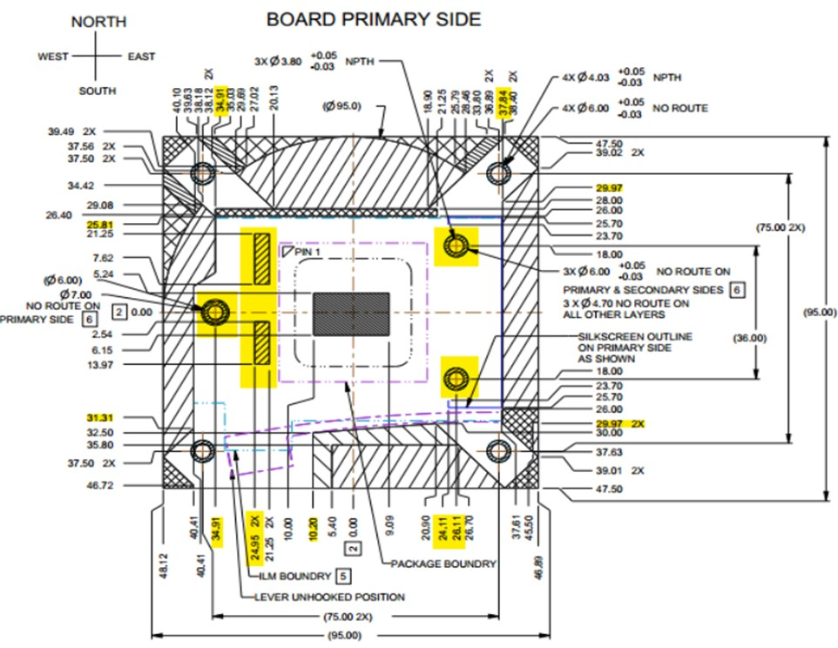
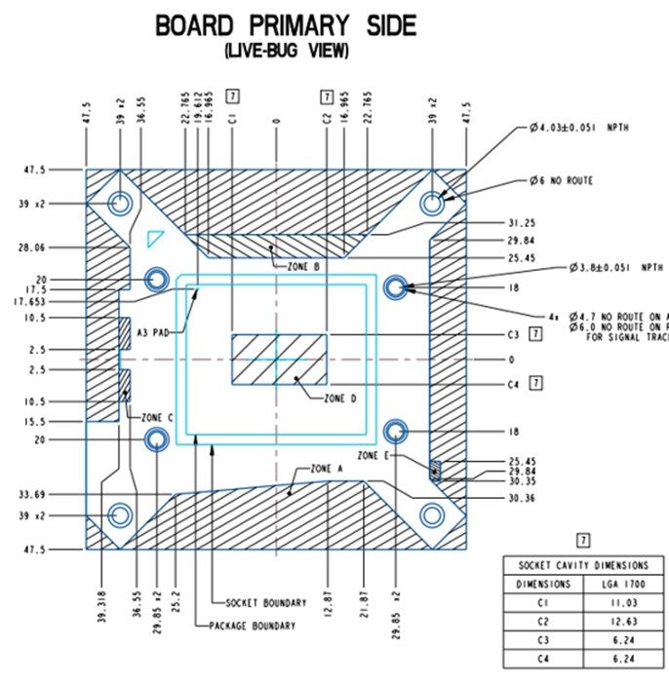
Socket-H5 (CML-S/RKL-S) | Socket-V (ADL-S)
95mm
95mm
75mm
78mm
Any possibility in making both hole pattern same for both products to allow same heatsink used ?

Slide 36
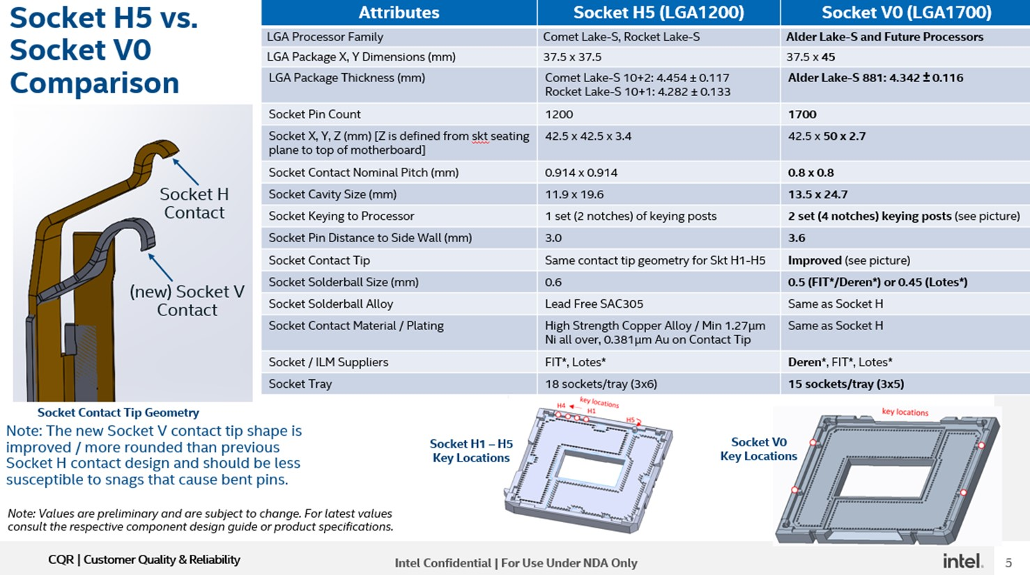
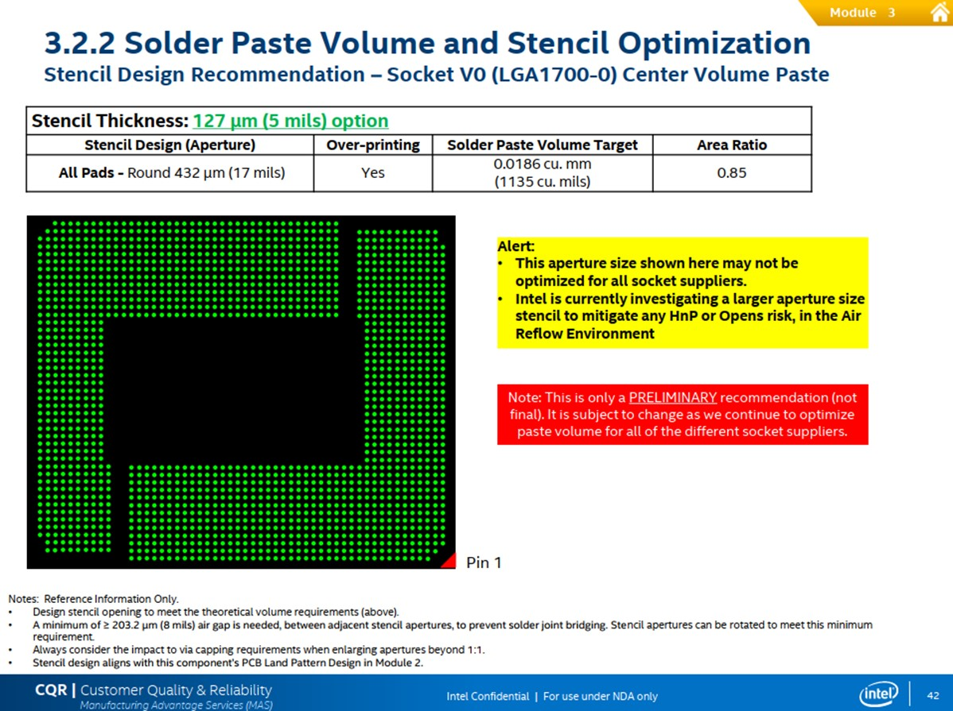
LOTES solder ball size is smaller than Deren & FIT, customer’s concerns with SJQ with the same paste volume recommended in MAS across all socket supplier.

Slide 37
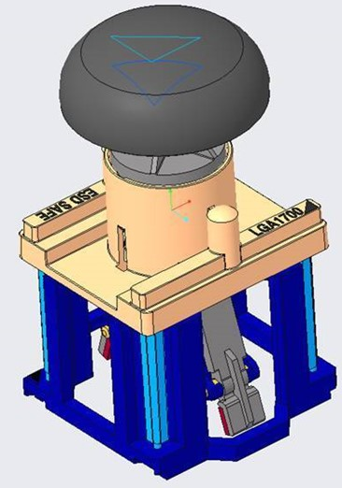
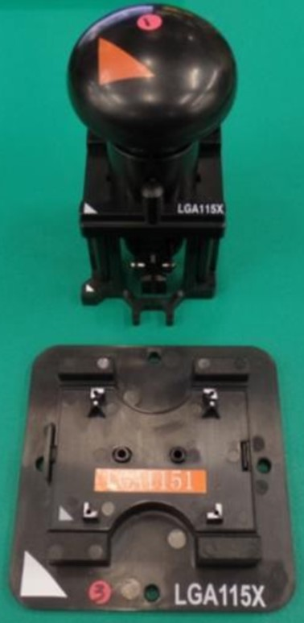
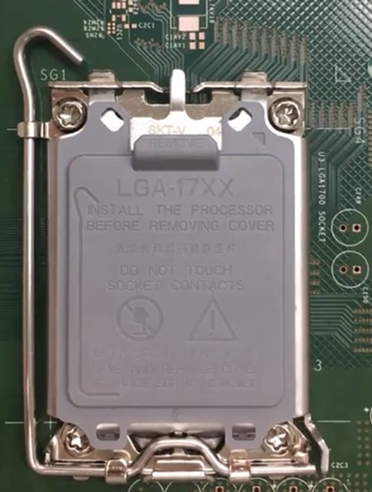
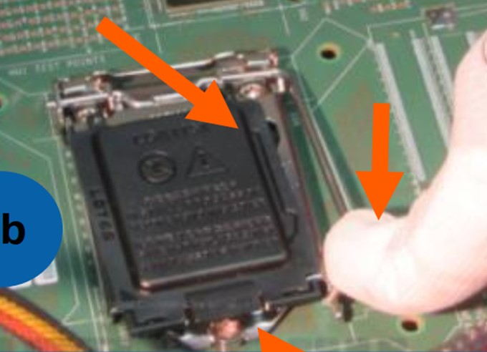
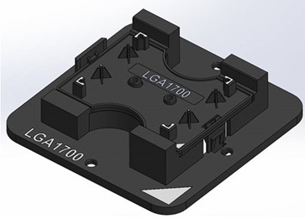
Socket-H | Socket-V
Lever latch outward (with left hand)
Pin 1, diagonally opposite compare to skt-H & also PnP tool / stage
Lever latch inward (with right hand)
Which Pin 1 label is correct ?
Consistent Pin 1 indication on tools and PCB
Pin 1
The Pin 1 mark on tools are inconsistent to Pin 1 indicator on PCB
Pin 1
Pin 1
Note:
Operator needs to rotate processor 180° from PnP tool/stage in order to align to PCB Pin 1.
Any possibility to make changes for socket-V the ILM to allow customer process transparency and mitigate execution error for manual process ?eg. 180° marking orientation change on ILM cover marking
This site facing operator
(it will be inconvenient for same operator to process skt-H and skt-V, and possibly error in execution, due to the need to rotate the processor 180° orientation)

Slide 38
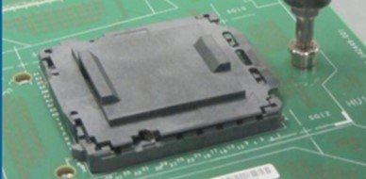
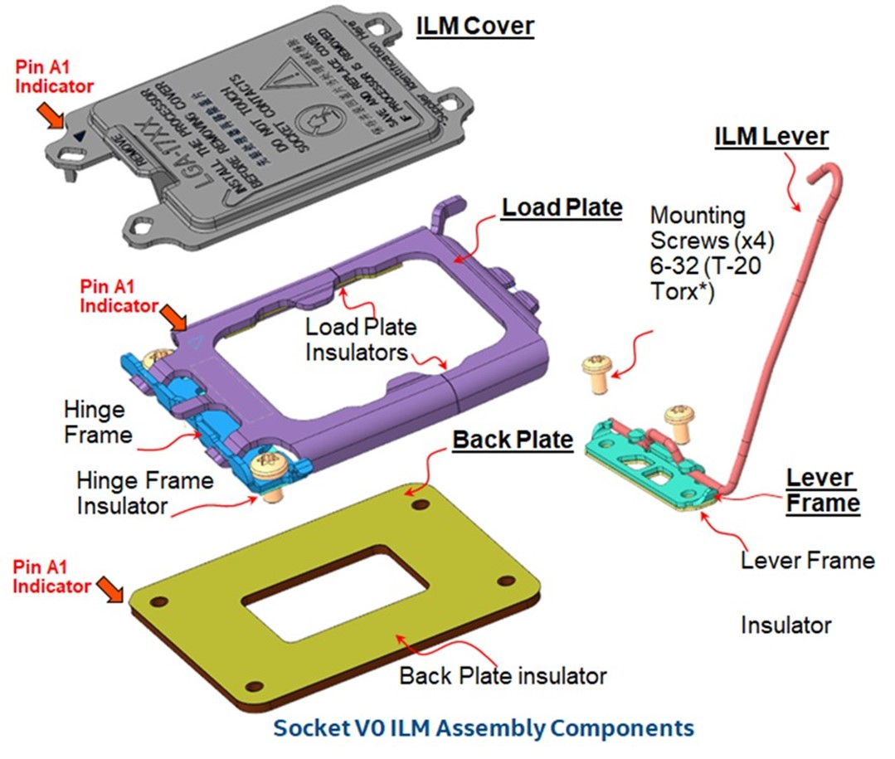
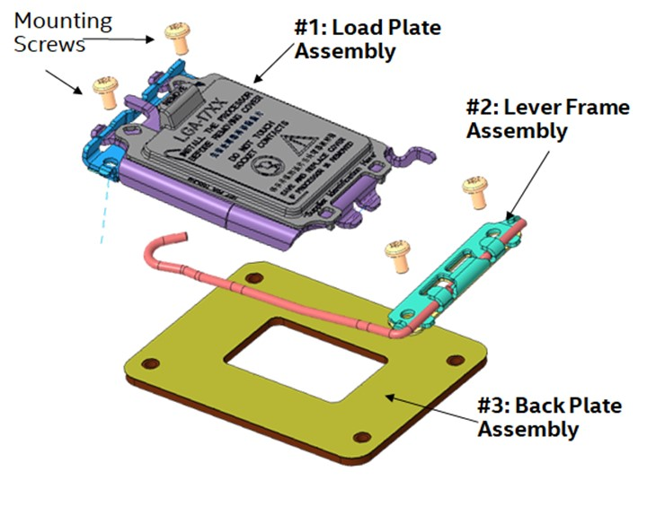
Skt-H, fool proof for wrong orientation
Socket V0 ILM Sub-Assemblies
Manual Asembly risk
PCB Top Side> Potential/risk for operator swapped lever frame and load plate locations during assembly.
Backplate> Potentially 180° orientation assembled.
Piece Parts Interchangability
Need to ensure all 4 mounting screws are same part number# .
Allow mixed vendor for piece parts (including different socket vendors to ILM vendors).

Slide 39
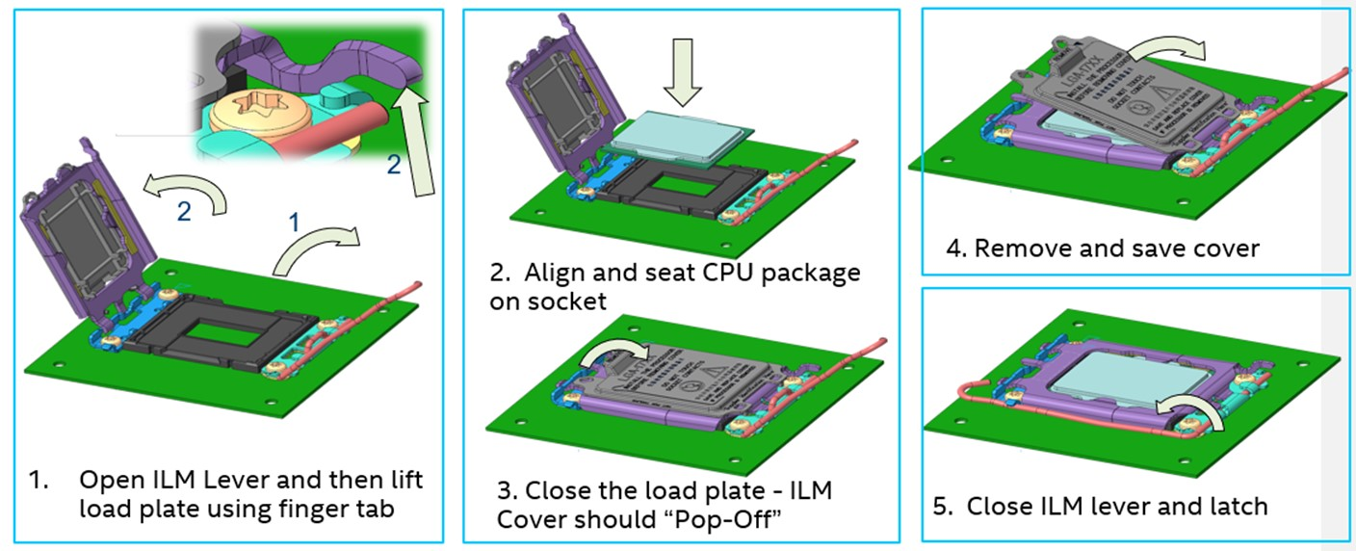
Automation Assessment/concerns:
Will the top plate & lever arm will stay permanently (height & angle) when moving at conveyor belt to next process/operator to install processor ?
What is the height / angle of the top-plate and lever arm ? (Machine PnP assessment)
Where is the locking position for load plate to push the ILM cover to pop-up ? Should the cover pop-up happen after lever is latch ?

Slide 40
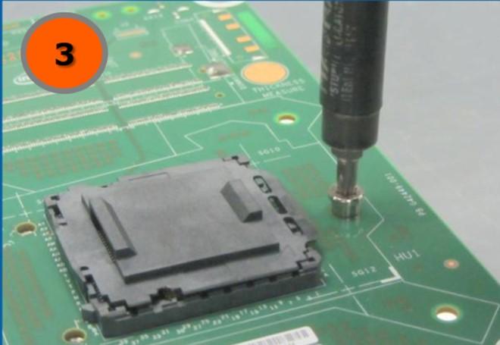
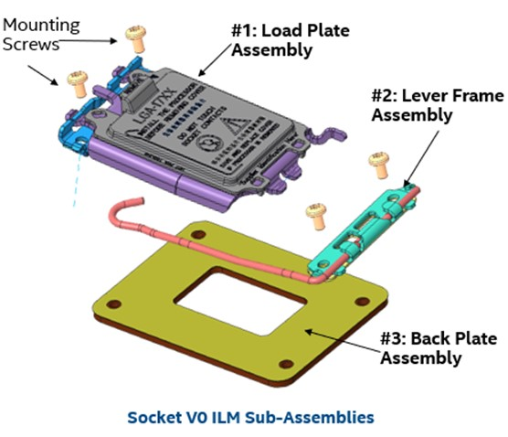
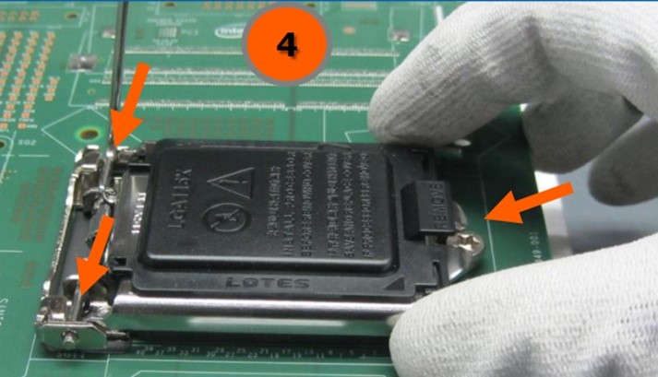
Socket-H | Socket-V
4-screw
3-screw
2-pcs ILM : top plate and lever frame
Customer needs to mix vendors for backplate, load plate, lever frame, screws & etc, is this allowable ?
1-pcs ILM top plate

Slide 41
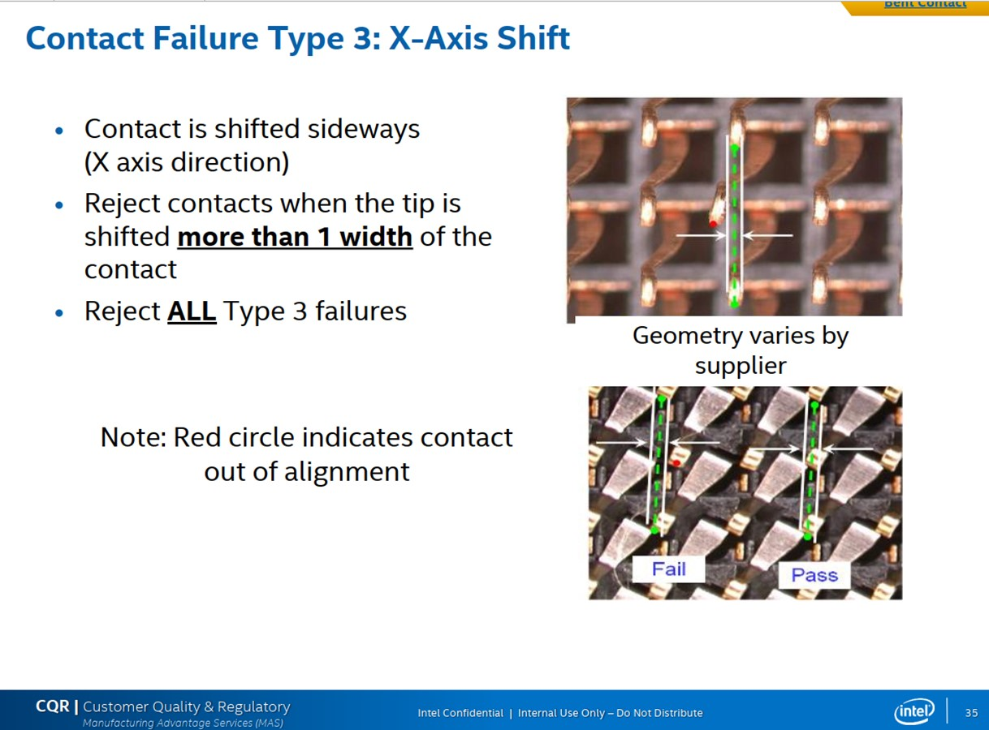
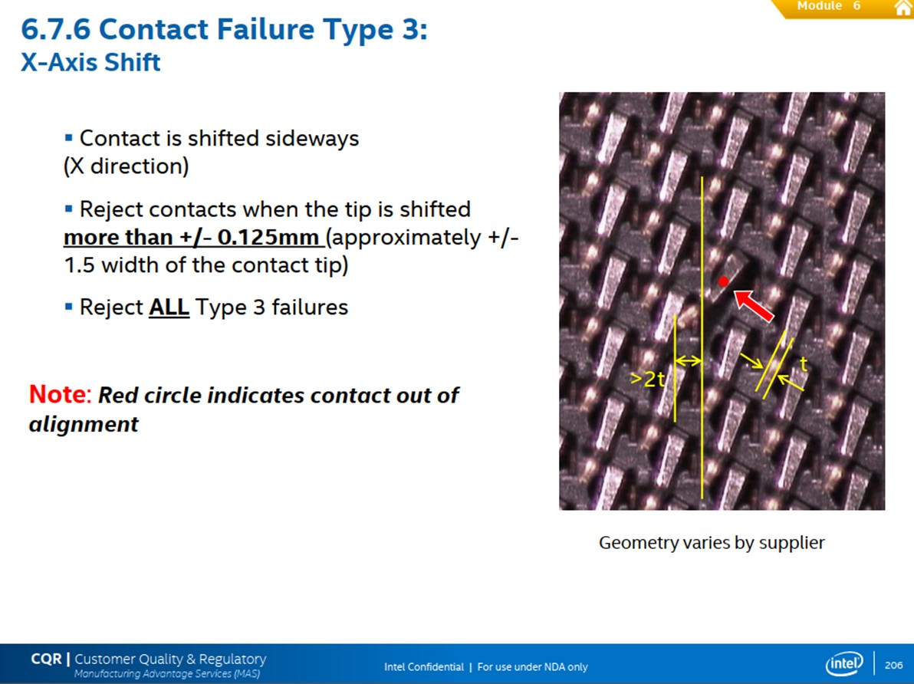
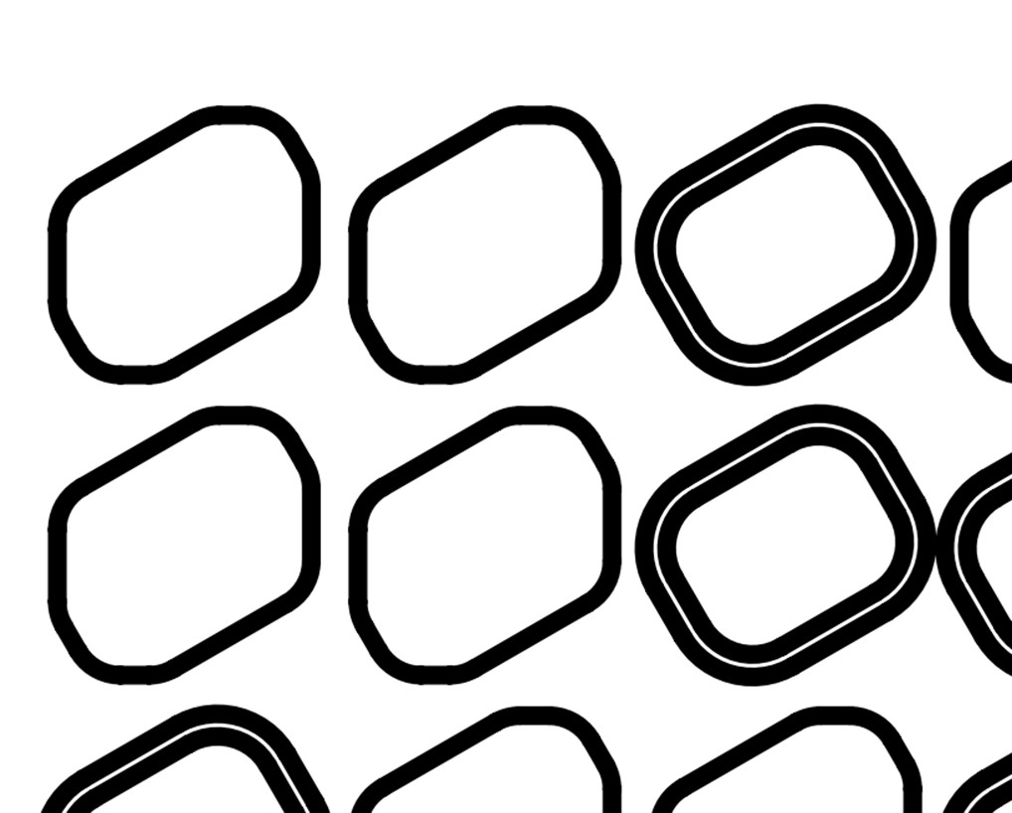
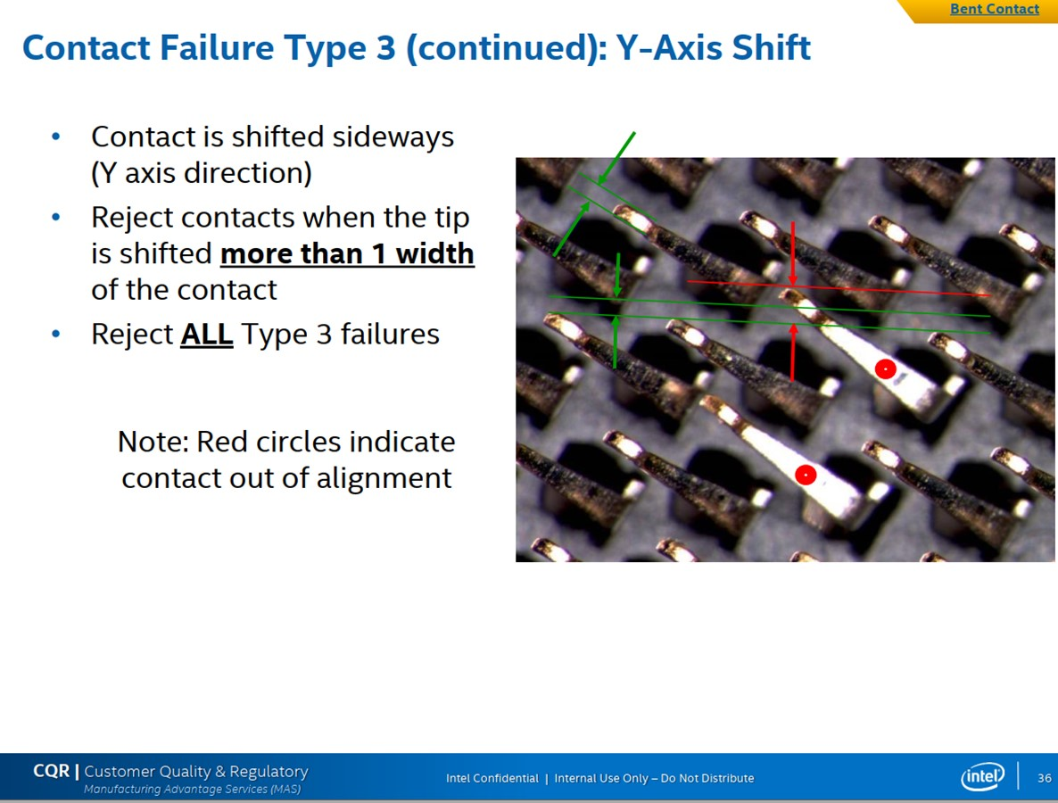
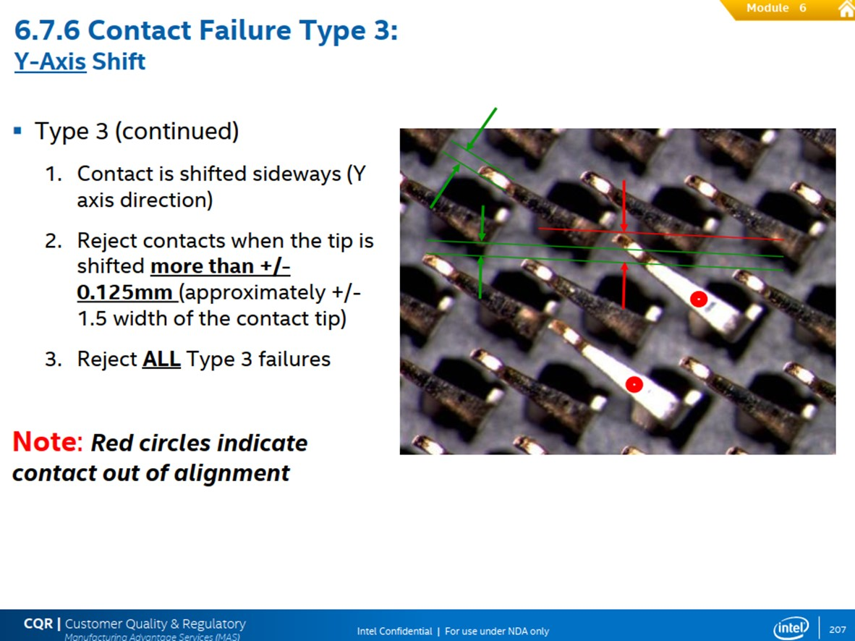
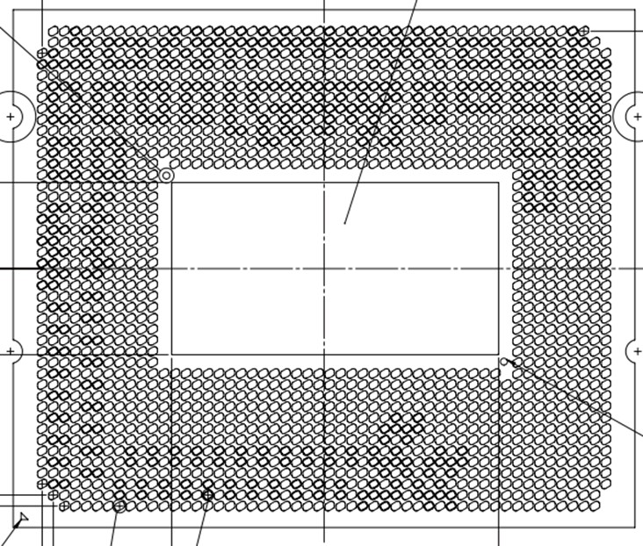
Socket-H MAS CDI# 561049 | Socket-V, Socket-P and Socket P4/5 MAS
Is the pin contact always contacted at the center of the LGA pad or near pad edge ? with the process variation and X-Y shift, will the pin be touching LGA Au pad or outside the Au pad (Solder resist area) or adjacent Au pad ? -- Need Intel design to assess
>±0.125mm or ± 1.5 width of contact
>1 width of contact
Tighter pitch but more relax criteria ?
original >1 width vs current >1.5 width

